Slide 1
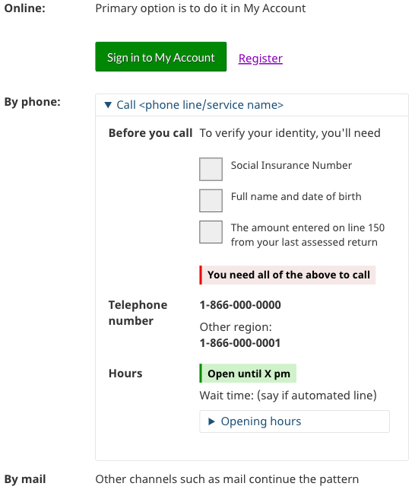
Design pattern for top contact task pages
Variants of this design pattern for contact channels for a task were used but this was the most effective version.
Used on pages linked from Contact us:
Notice of assessment
Proof of income
Direct deposit
Canada Child Benefit
Issues with payments
Change address & details
…
Some in Contact when have no other task home (e.g. NOA), some within tasks (e.g.CCB)
Channel headings in a left column
Online first, as the primary channel
Expand collapse pattern, particularly important when >1 phone number
Phone number always displayed with before you call and hours

Slide 2
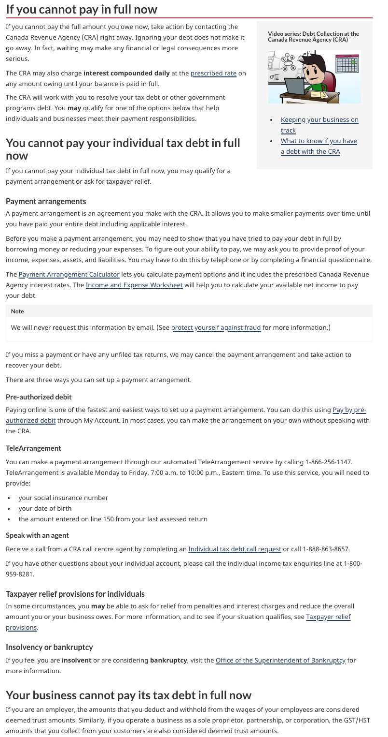
Choose not Find: Make people aware there is a choice to make
Many scan and pick the first number they see - wrong
No one makes the distinction that the page is divided for two audiences
Conscious choices needs to be made before a phone number is shown

Slide 3
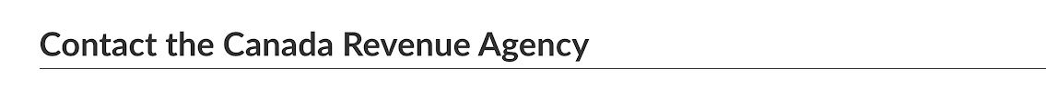
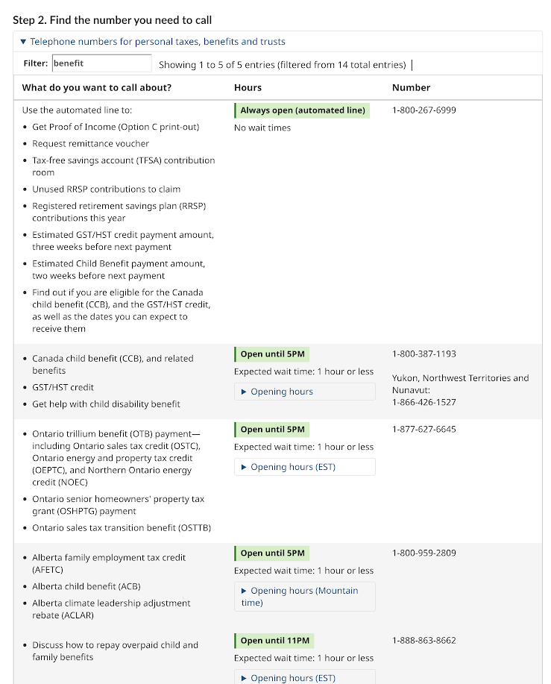
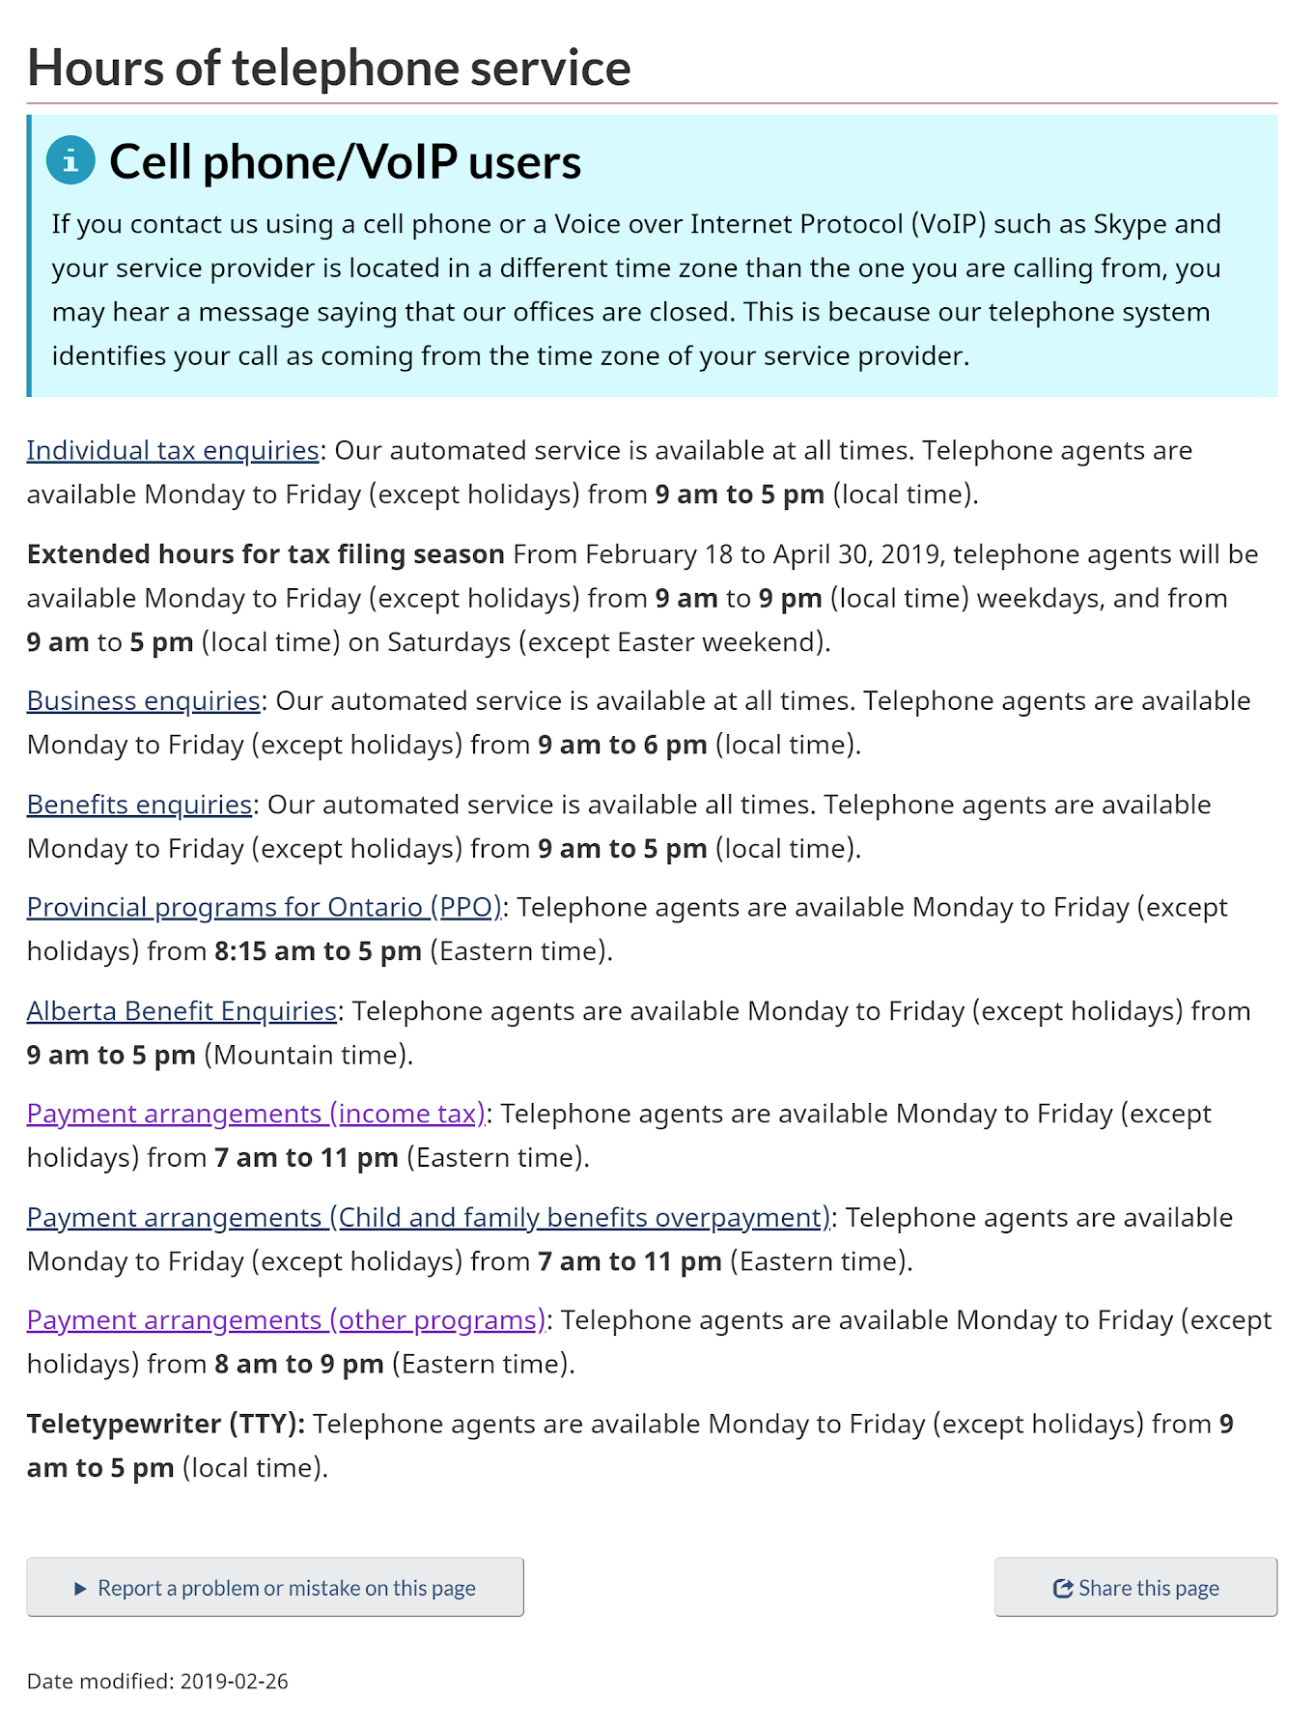
Reduce calls - highlight automated line hours
People saw the hours, understood “Always open” for automated
Hours on a seperate page - few clicks in analytics - nothing about automated lines as an alternative
People saw the bullets for their type of problem

